Slide 1
Turning Linear Models into Nonlinear Models using Kernel Methods
CSN-382

Slide 2
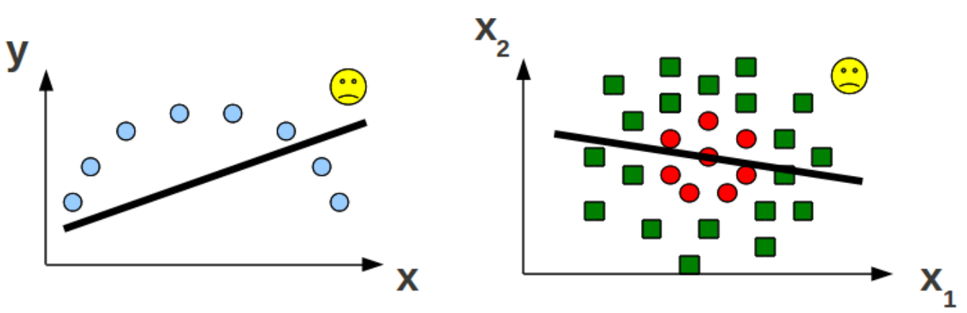
Linear Models
Nice and interpretable but can’t learn “difficult” nonlinear patterns
So, are linear models useless for such problems?

Slide 3

Linear Models for Nonlinear Problems
Consider the following one-dimensional inputs from two classes
Can’t separate using a linear hyperplane
$$x$$

Slide 4
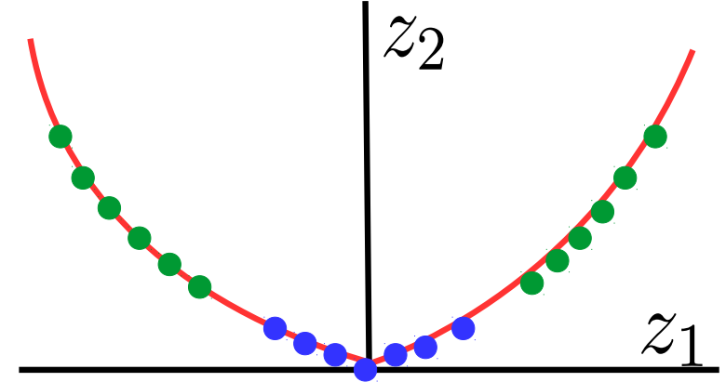

Linear Models for Nonlinear Problems
Consider mapping each $x$ to two-dimensions as $x→ z = \left[z_{1},z_{2}\right]=[x,x^{2}]$
Classes are now linearly separable in the two-dimensional space
Linear hyperplane

Slide 5
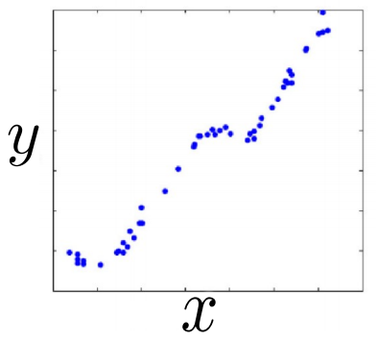
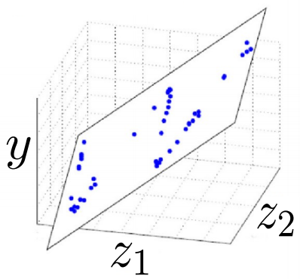

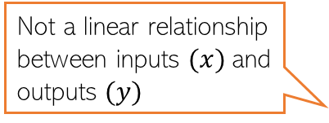
Linear Models for Nonlinear Problems
The same idea can be applied for nonlinear regression as well
$$x→ z = \left[z_{1},z_{2}\right]=[x,cos(x)]$$
Not a linear relationship between inputs $(x)$and outputs $(y)$
A linear regression model will not work well
A linear regression model will work well with this new two-dim representation of the original one-dim inputs

Slide 6
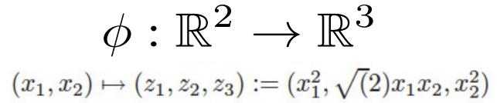
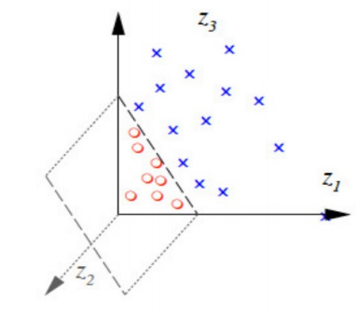
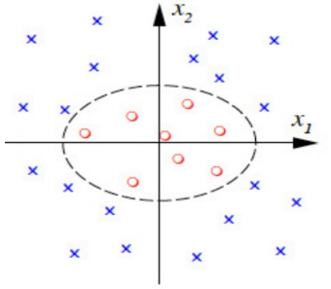

Linear Models for Nonlinear Problems
Can assume a feature mapping $φ$ that maps/transforms the inputs to a “nice” space
.. and then happily apply a linear model in the new space!
The linear model in the new feature space corresponds to a nonlinear model in the original feature space

Slide 7
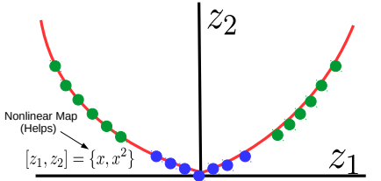
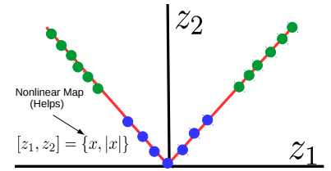
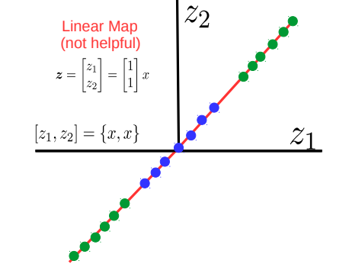
Not Every Mapping is Helpful
Not every higher-dim mapping helps in learning nonlinear patterns
Must be a nonlinear mapping
For the nonlin classfn problem we saw earlier, consider some possible mappings

Slide 8

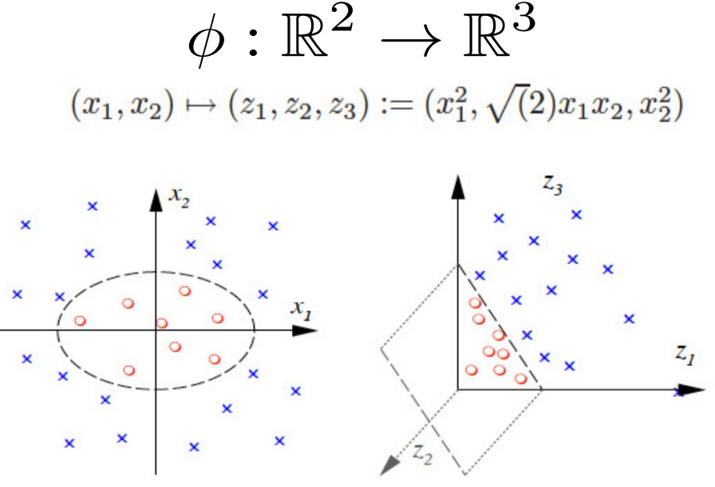

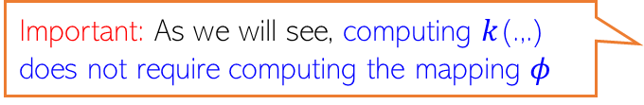

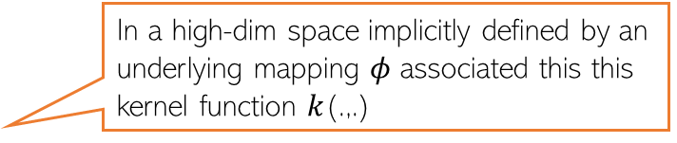
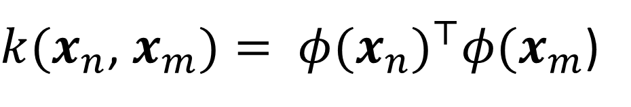
How to get these “good” (nonlinear) mappings?
Can try to learn the mapping from the data itself (e.g., using deep learning - later)
Can use pre-defined “good” mappings (e.g., defined by kernel functions - today’s topic)
Kernel: A function $k$(.,.) that gives dot product similarity b/w two inputs, say $x_{n}$ and $x_{m}$
Thankfully, using kernels, you don’t need to compute these mappings explicitly
Even if I knew a good mapping, it seems I need to apply it for every input. Won’t this be computationally expensive?
The kernel will define an “implicit” feature mapping
Important: The idea can be applied to any ML algo in which training and test stage only require computing pairwise similarities b/w inputs
Also, the number of features will increase? Will it not slow down the learning algorithm?
In a high-dim space implicitly defined by an underlying mapping $φ$ associated this this kernel function $k$(.,.)
Important: As we will see, computing $k$(.,.) does not require computing the mapping $φ$
$k(x_{n}$, $x_{m})= {φ(x_{n})}^{⊤}φ(x_{m}$)

Slide 9
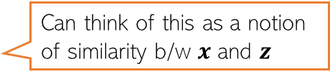






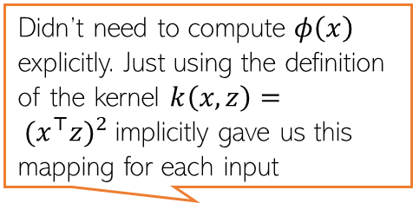


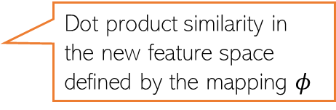
Kernels as (Implicit) Feature Maps
Consider two inputs (in the same two-dim feature space): $x = [x_{1},x_{2}], z = [z_{1},z_{2}]$
Suppose we have a function $k(.,.)$ which takes two inputs $x$ and $z$ and computes
Also didn’t have to compute ${φ\left(x\right)}^{⊤}φ(z)$. Defn $k\left(x,z\right)= {(x^{⊤}z)}^{2}$ gives that
Called the “kernel function”
Can think of this as a notion of similarity b/w $x$ and $z$
This is not a dot/inner product similarity but similarity using a more general function of $x$ and $z$ (square of dot product)
$$k\left(x,z\right)= {(x^{⊤}z)}^{2}$$
Didn’t need to compute $φ\left(x\right)$ explicitly. Just using the definition of the kernel $k\left(x,z\right)= {(x^{⊤}z)}^{2}$implicitly gave us this mapping for each input
$= {(x_{1}z_{1}+x_{2}z_{2})}^{2}$
$=x_{1}^{2}z_{1}^{2}+x_{2}^{2}z_{2}^{2}+2x_{1}x_{2}z_{1}z_{2}$
Remember that a kernel does two things: Maps the data implicitly into a new feature space (feature transformation) and computes pairwise similarity between any two inputs under the new feature representation
Thus kernel function $k\left(x,z\right)= {(x^{⊤}z)}^{2}$
implicitly defined a feature mapping $φ$such that for $x = [x_{1},x_{2}]$ , $φ\left(x\right)=\left(x_{1}^{2},\sqrt{2}x_{1}x_{2},x_{2}^{2}\right)$
$= {\left(x_{1}^{2},\sqrt{2}x_{1}x_{2},x_{2}^{2}\right)}^{⊤}(z_{1}^{2},\sqrt{2}z_{1}z_{2},z_{2}^{2})$
$= {φ\left(x\right)}^{⊤}φ(z)$
Dot product similarity in the new feature space defined by the mapping $φ$

Slide 10
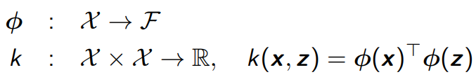
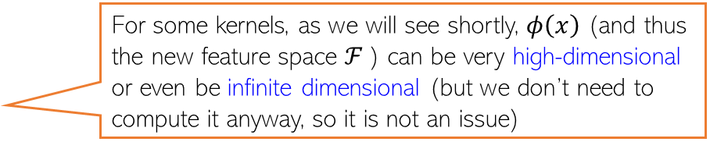
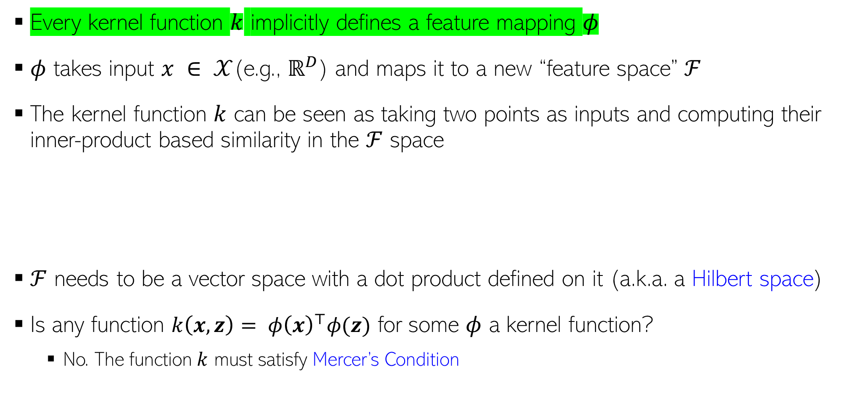
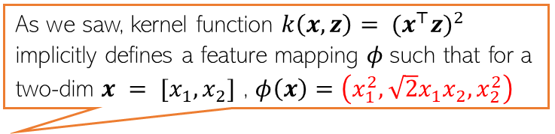
Kernel Functions
As we saw, kernel function $k\left(x,z\right)= {(x^{⊤}z)}^{2}$
implicitly defines a feature mapping $φ$such that for a two-dim $x = [x_{1},x_{2}]$ , $φ\left(x\right)=\left(x_{1}^{2},\sqrt{2}x_{1}x_{2},x_{2}^{2}\right)$
Every kernel function $k$ implicitly defines a feature mapping $φ$
$φ$ takes input $x ∈ 𝒳$(e.g., $ℝ^{D}$) and maps it to a new “feature space” $ℱ$
The kernel function $k$ can be seen as taking two points as inputs and computing their inner-product based similarity in the $ℱ$ space
$ℱ$ needs to be a vector space with a dot product defined on it (a.k.a. a Hilbert space)
Is any function ${k\left(x,z\right)= φ\left(x\right)}^{⊤}φ(z)$ for some $φ$ a kernel function?
No. The function $k$ must satisfy Mercer’s Condition
For some kernels, as we will see shortly, $φ\left(x\right)$ (and thus the new feature space $ℱ$) can be very high-dimensional or even be infinite dimensional (but we don’t need to compute it anyway, so it is not an issue)

Slide 11
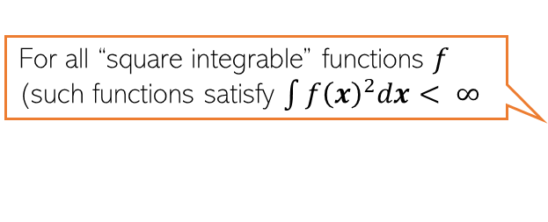
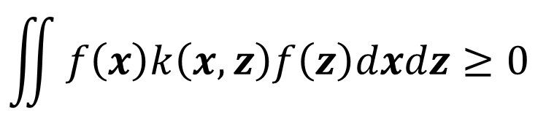

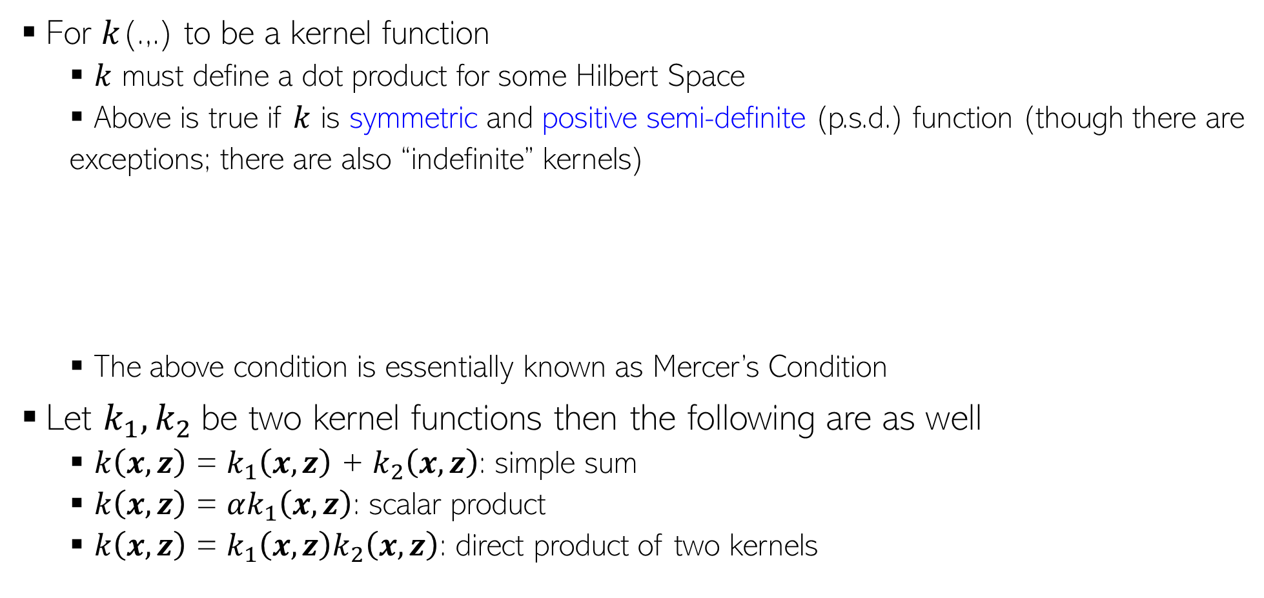
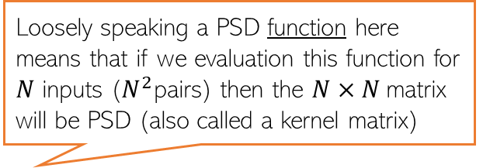
Kernel Functions
For $k$(.,.) to be a kernel function
$k$ must define a dot product for some Hilbert Space
Above is true if $k$ is symmetric and positive semi-definite (p.s.d.) function (though there are
exceptions; there are also “indefinite” kernels)
The above condition is essentially known as Mercer’s Condition
Let $k_{1}, k_{2}$be two kernel functions then the following are as well
$k\left(x,z\right)$ = $k_{1}\left(x,z\right)$ + $k_{2}\left(x,z\right)$: simple sum
$k\left(x,z\right)$ = $αk_{1}\left(x,z\right)$: scalar product
$k\left(x,z\right)$ = $k_{1}\left(x,z\right)k_{2}\left(x,z\right)$: direct product of two kernels
Loosely speaking a PSD function here means that if we evaluation this function for $N$ inputs ($N^{2}$pairs) then the $N×N$matrix will be PSD (also called a kernel matrix)
$$k\left(x,z\right)=k(z,x)$$
For all “square integrable” functions $f$ (such functions satisfy $\int{f{\left(x\right)}^{2}dx< ∞}$
$$\iint{f\left(x\right)k\left(x,z\right)f\left(z\right)dxdz≥0 }$$
Can easily verify that the Mercer’s Condition holds
Can also combine these rules and the resulting function will also be a kernel function

Slide 12
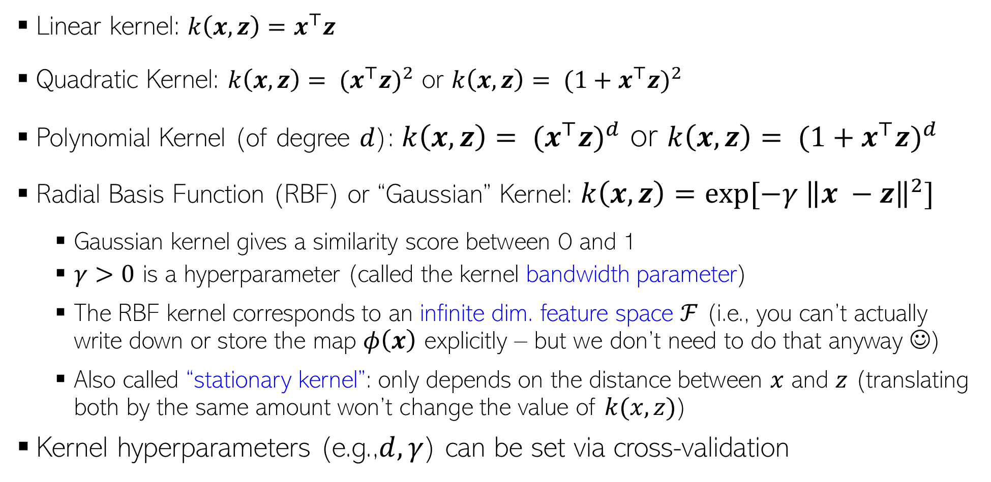
Some Pre-defined Kernel Functions
Several other kernels proposed for non-vector data, such as trees, strings, etc
Remember that kernels are a notion of similarity between pairs of inputs
Linear kernel: ${k\left(x,z\right)=x}^{⊤}z$
Quadratic Kernel: $k\left(x,z\right)= {(x^{⊤}z)}^{2}$ or $k\left(x,z\right)= {(1+x^{⊤}z)}^{2}$
Polynomial Kernel (of degree $d$): $k\left(x,z\right)= {(x^{⊤}z)}^{d}$ or $k\left(x,z\right)= {(1+x^{⊤}z)}^{d}$
Radial Basis Function (RBF) or “Gaussian” Kernel: $k\left(x,z\right)=exp[−γ {\left\|x −z\right\|}^{2}]$
Gaussian kernel gives a similarity score between 0 and 1
$γ>0$ is a hyperparameter (called the kernel bandwidth parameter)
The RBF kernel corresponds to an infinite dim. feature space $ℱ$ (i.e., you can’t actually write down or store the map $φ\left(x\right)$ explicitly – but we don’t need to do that anyway ☺)
Also called “stationary kernel”: only depends on the distance between $x$ and $z$ (translating both by the same amount won’t change the value of $k(x, z)$)
Kernel hyperparameters (e.g.,$d, γ$) can be set via cross-validation
Kernels can have a pre-defined form or can be learned from data (a bit advanced for this course)
Controls how the distance between two inputs should be converted into a similarity

Slide 13

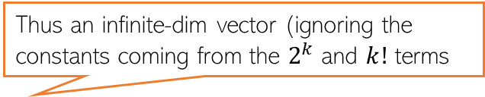


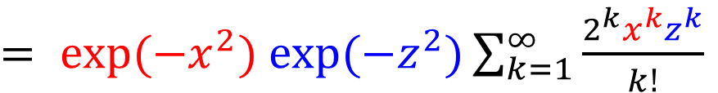
RBF Kernel = Infinite Dimensional Mapping
We saw that the RBF/Gaussian kernel is defined as $k\left(x,z\right)=exp[−γ {\left\|x −z\right\|}^{2}]$
Using this kernel corresponds to mapping data to infinite dimensional space
Here $φ\left(x\right)=[exp\left(−x^{2}\right)x^{1},exp\left(−x^{2}\right)x^{2}$, $exp\left(−x^{2}\right)x^{3},…,exp\left(−x^{2}\right)x^{∞}]$
But again, note that we never need to compute $φ\left(x\right)$ to compute $k\left(x,z\right)$
$k\left(x,z\right)$ is easily computable from its definition itself ($exp[−{\left(x−z\right)}^{2}]$ in this case)
$$k\left(x,z\right)= exp[−{\left(x−z\right)}^{2}]$$
$$(assuming γ=1 and x and z to be scalars)$$
$= exp(−x^{2})$ $exp(−z^{2})exp(2xz)$
$= exp(−x^{2})$ $exp(−z^{2})\sum_{k=1}^{∞}{\frac{2^{k}x^{k}z^{k}}{k!}}$
$${=φ\left(x\right)}^{⊤}φ(z)$$
Thus an infinite-dim vector (ignoring the constants coming from the $2^{k}$ and $k!$ terms

Slide 14
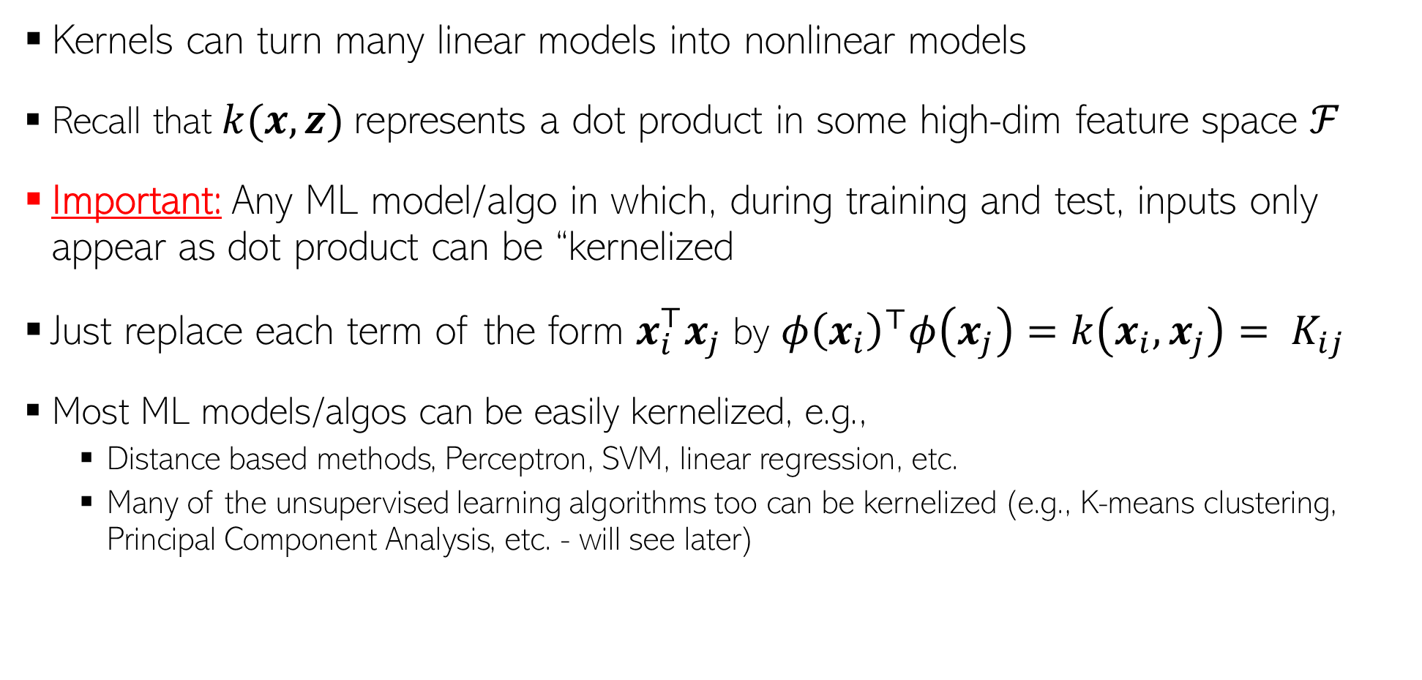
Using Kernels
Kernels can turn many linear models into nonlinear models
Recall that $k(x, z)$represents a dot product in some high-dim feature space $ℱ$
Important: Any ML model/algo in which, during training and test, inputs only appear as dot product can be “kernelized
Just replace each term of the form $x_{i}^{⊤}x_{j}$ by ${φ\left(x_{i}\right)}^{⊤}φ\left(x_{j}\right)=k\left(x_{i},x_{j}\right)= K_{ij}$
Most ML models/algos can be easily kernelized, e.g.,
Distance based methods, Perceptron, SVM, linear regression, etc.
Many of the unsupervised learning algorithms too can be kernelized (e.g., K-means clustering, Principal Component Analysis, etc. - will see later)

Slide 15




An Aside: Kernelizing a Euclidean Distance
Many algorithms, e.g., LwP, KNN, etc. use Euclidean distances, e.g.,
This can be kernelized as well by replacing the above norms and inner products by their kernelized versions, assuming a kernel $k$ with feature map $φ$
$$d\left(a,b\right)={\left\|a−b\right\|}^{2}$$
$$={\left\|a\right\|}^{2}+{\left\|b\right\|}^{2}−2a^{⊤}b$$
$$=a^{⊤}a+b^{⊤}b−2a^{⊤}b$$
$$d\left(φ(a),φ(b)\right)={\left\|φ(a)−φ(b)\right\|}^{2}$$
$$={φ(a)}^{⊤}φ(a)+{φ(b)}^{⊤}φ(b)−2{φ(a)}^{⊤}φ(b)$$
$$=k(a,a)+k(b,b)−2k(a,b)$$

Slide 16
Nonlinear SVM using Kernels

Slide 17
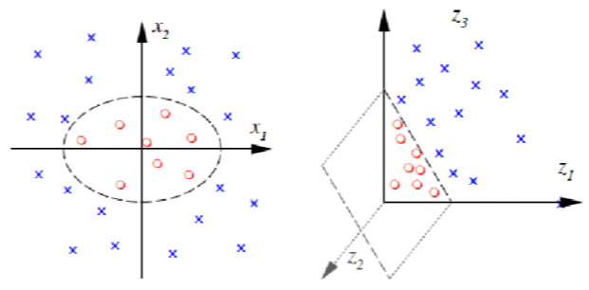

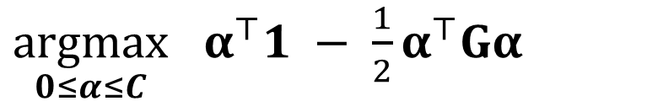
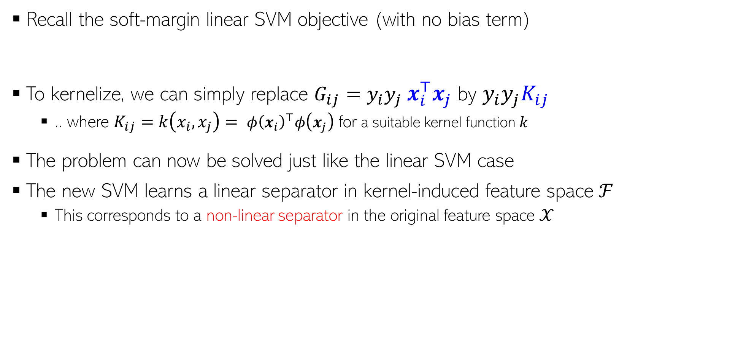
Kernelized SVM Training
Inputs only appear as dot products ☺
Recall the soft-margin linear SVM objective (with no bias term)
To kernelize, we can simply replace $G_{ij}=y_{i}y_{j}$ $x_{i}^{⊤}x_{j}$ by $y_{i}y_{j}K_{ij}$
.. where $K_{ij}=k\left(x_{i},x_{j}\right)= {φ\left(x_{i}\right)}^{⊤}φ\left(x_{j}\right)$ for a suitable kernel function $k$
The problem can now be solved just like the linear SVM case
The new SVM learns a linear separator in kernel-induced feature space ℱ
This corresponds to a non-linear separator in the original feature space $𝒳$
$\underset{0≤α≤C}{argmax}$ $α^{⊤}1 − \frac{1}{2}α^{⊤}Gα$
$G_{ij}=y_{i}y_{j}$ $x_{i}^{⊤}x_{j}$

Slide 18
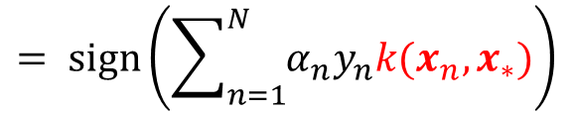
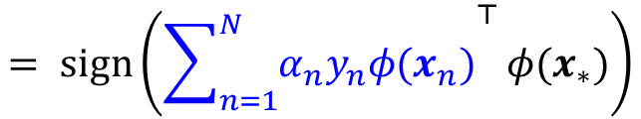

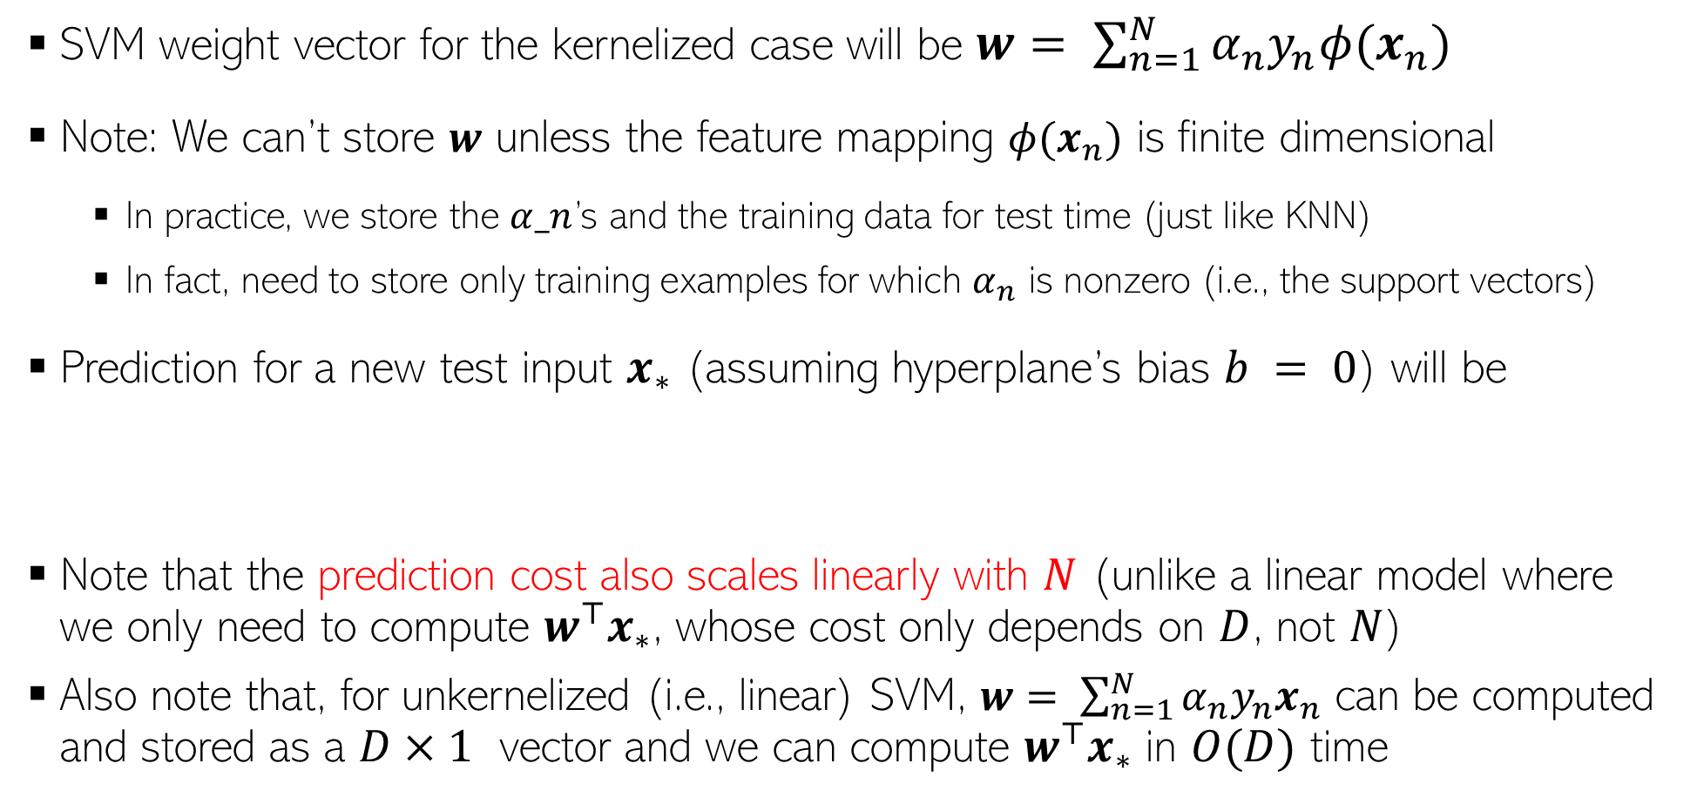
Kernelized SVM Prediction
SVM weight vector for the kernelized case will be $w= \sum_{n=1}^{N}{α_{n}y_{n}φ(x_{n})}$
Note: We can’t store $w$ unless the feature mapping $φ(x_{n})$ is finite dimensional
In practice, we store the $α_n$’s and the training data for test time (just like KNN)
In fact, need to store only training examples for which $α_{n}$ is nonzero (i.e., the support vectors)
Prediction for a new test input $x_{∗}$ (assuming hyperplane’s bias $b = 0$) will be
Note that the prediction cost also scales linearly with $N$ (unlike a linear model where we only need to compute $w^{⊤}x_{∗}$, whose cost only depends on $D$, not $N$)
Also note that, for unkernelized (i.e., linear) SVM, $w= \sum_{n=1}^{N}{α_{n}y_{n}x_{n}}$ can be computed and stored as a $D×1$ vector and we can compute $w^{⊤}x_{∗}$ in $O(D)$ time
$$= sign\left({\sum_{n=1}^{N}{α_{n}y_{n}φ(x_{n})}}^{⊤}{φ(x}_{∗})\right)$$
$$= sign\left(\sum_{n=1}^{N}{α_{n}y_{n}k(x_{n},x_{∗})}\right)$$
$$y_{∗}= sign(w^{⊤}{φ(x}_{∗}))$$
Notes:
Feature mapping phi can be infinite dimensional or may have range space as very large dimensional and hence we can’t compute w during training. We only store alpha and the training data (just like KNN).
At test time, the value of w can be calculated and then used for prediction.

